Slide 1
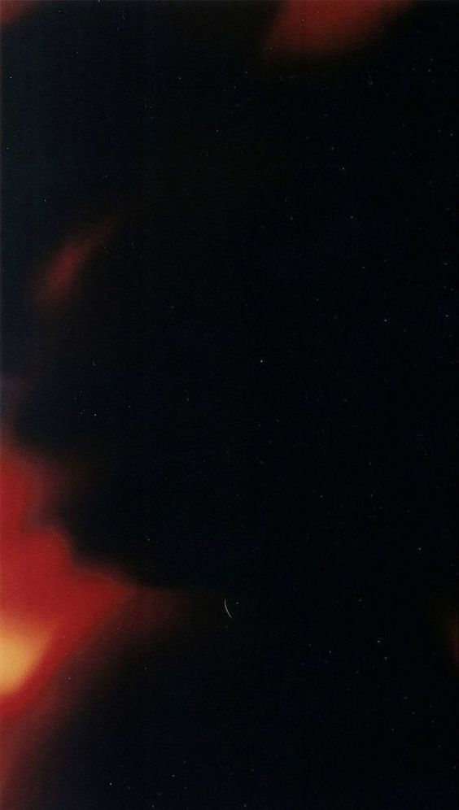


i m a y a

Slide 2
i m a y a
Sarah Khan, Sahla Kader, Fatimah Riaz, Aniq Shaikh

Slide 3
The Problem
The death rate in the construction industry is
4.2
1 in 5
times higher
of all work deaths
60,000
deaths per year

Slide 4
The Problem
The death rate in the construction industry is
4.2
1 in 5
times higher
of all work deaths
60,000
deaths per year

Slide 5
The Problem
The death rate in the construction industry is
4.2
60,000
1 in 5
times higher
deaths per year
of all work deaths

Slide 6
The Problem
The death rate in the construction industry is
4.2
60,000
1 in 5
times higher
deaths per year
of all work deaths

Slide 7

$151 Billion per year
1 time injury costs $35,000
year.

Slide 8
$151 Billion per year
1 time injury costs $35,000
year.

Slide 9

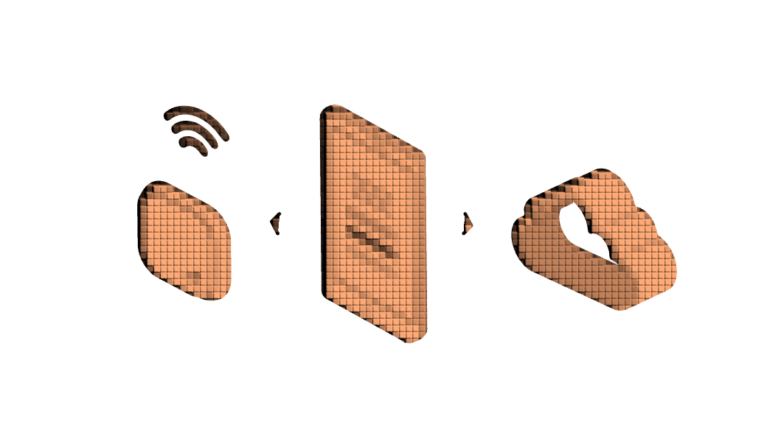

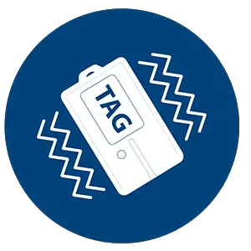

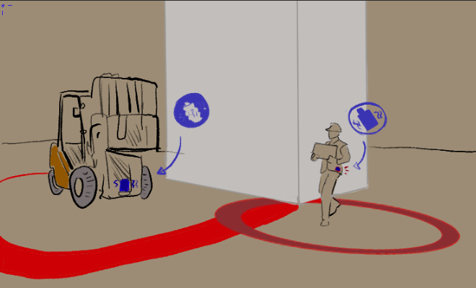

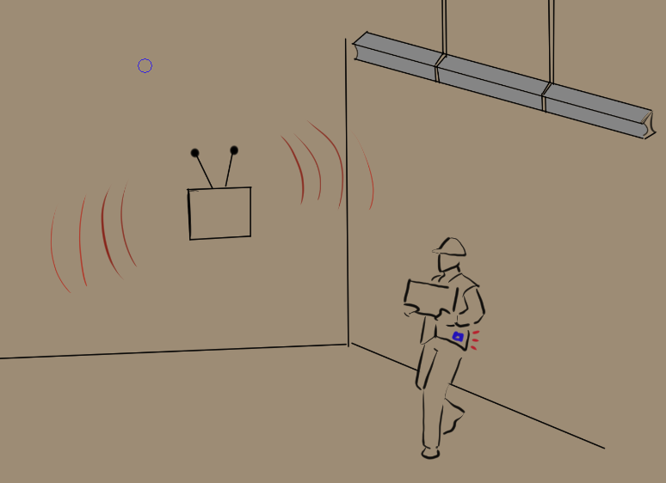
From Trauma to Revolution
V-Tag
i m a y a
$$$

Slide 10
From Trauma to Revolution
V-Tag
i m a y a
$$$

Slide 11
i m a y a
Sarah Khan, Sahla Kader, Fatimah Riaz, Aniq Shaikh

Slide 12
Initial Funding: $350,000
The death rate in the construction industry is 4.2 times higher than that in ALL other industries, with more than
workers dying on construction sites
Development
Marketing
$80,000
$50,000
V-Tag
60,000
Company Expenses
Inventory
$100,000
$120,000

Slide 13
V-Tag
Antenna

Slide 14
Control Unit
V-Tag
Antenna

Slide 15
V-Tag
Antenna
Control Unit
$39.99
$199.99
w/Antenna $899.99

Slide 19
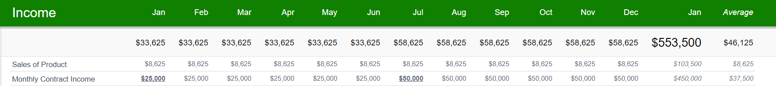
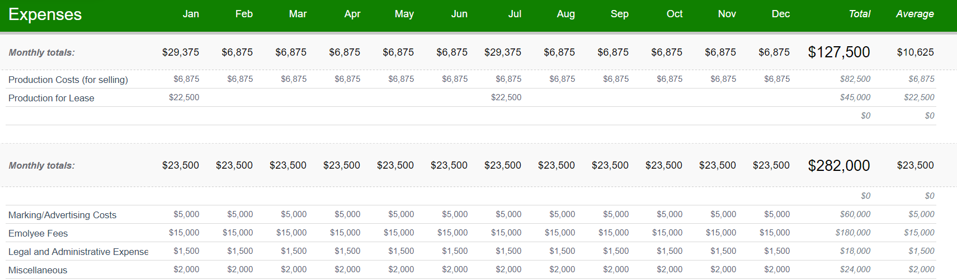
Finance Details
Starter Bundle
Control Unit + Antenna + 25 V-Tags : $1199.99

Slide 20
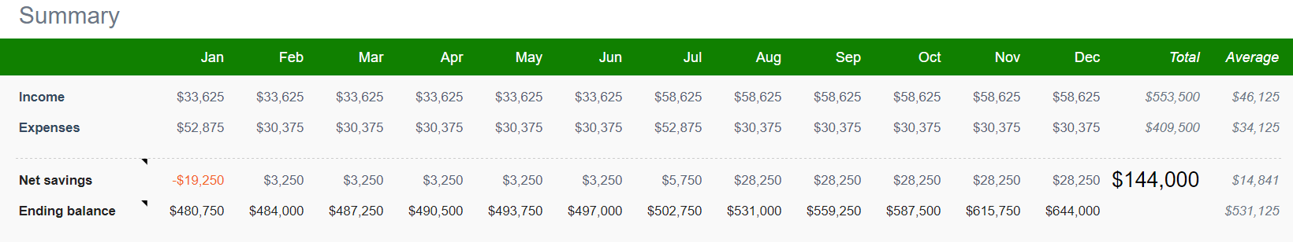
Finance Summarized
Initial Funding: $500,000
Year 1 Profit: $144,000
*Hybrid Model*

Slide 21
Finance Broken Down: Sales
 | Cost of Good | Consumer Price
V-Tag | $20 | $25
Antenna | $135 | $175
Control Unit | $500 | $600
Monthly Estimates (# of Sales per month):
V-Tag – 50
Antenna – 25
Control Unit – 5
Cost: 6875
Revenue: 8625
Yearly Estimates (# of Sales per month):
V-Tag – 50
Antenna – 25
Control Unit – 5
Cost: 6875
Revenue: 8625

Slide 22
Finance Broken Down: Contracts
Contract Type | Price (per month for duration of project)
Small Business | $5,000
Enterprise | $10,000
Semester 1(Jan-Jun):
V-Tag – 200
Antenna – 100
Control Unit – 20
Cost: 25500
Semester 2 (Jul-Dec):
V-Tag – 200 + 200
Antenna – 100 + 100
Control Unit – 100 + 1000
Cost: 51000

Slide 23
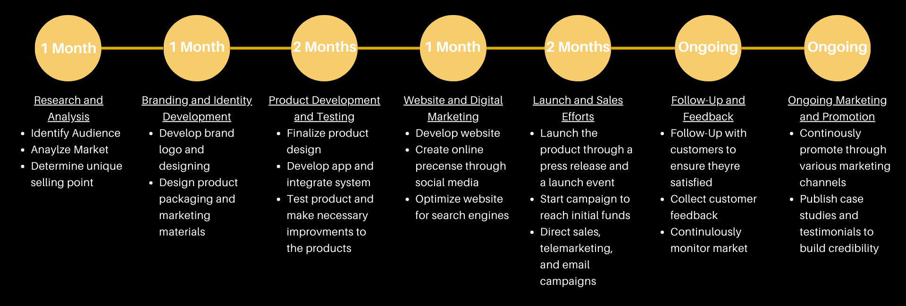
Marketing Timeline

Slide 24
Weight of Power
i m a y a
“each and every one of you is like a shepherd, and each and every one of you has a flock to take care of, and each and every single one of you will be held responsible”
(Bukhari)
جَزَاكَ ٱللَّٰهُ خَيْرًا

Slide 25
i m a y a
جَزَاكَ ٱللَّٰهُ خَيْرًا

